Slide 1
Final Project:
Adaptive Soundscape
Jacob Jiang

Slide 2
Demo:
https://adaptive-soundscape.vercel.app/

Slide 3
Code Snippet:
Creating Realistic Wind Sound Using Web Audio API
Web Audio API Terminology
Nodes: Act as individual building blocks in the sound studio
Source Nodes: Create sound
Process Nodes: Modify sound (filters, gains, oscillators)
Destination: Speakers/Headphones

Slide 4
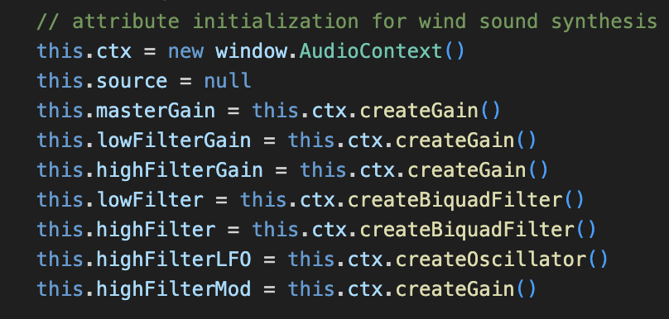
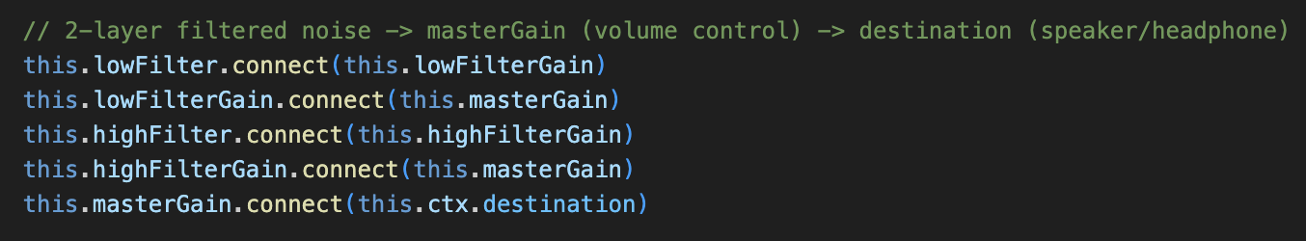
Code Snippet:
Set up the audio engine
createGain : Volume Control
createBiquadFilter : Filter sound
Both create nodes
this.[connectFrom].connect(this.[connectTo])

Slide 5
Code Snippet:
Low Filter
Gain
Low Filter
Master
Gain
Destination
High Filter
Gain
High Filter
Problem: No source!

Slide 6
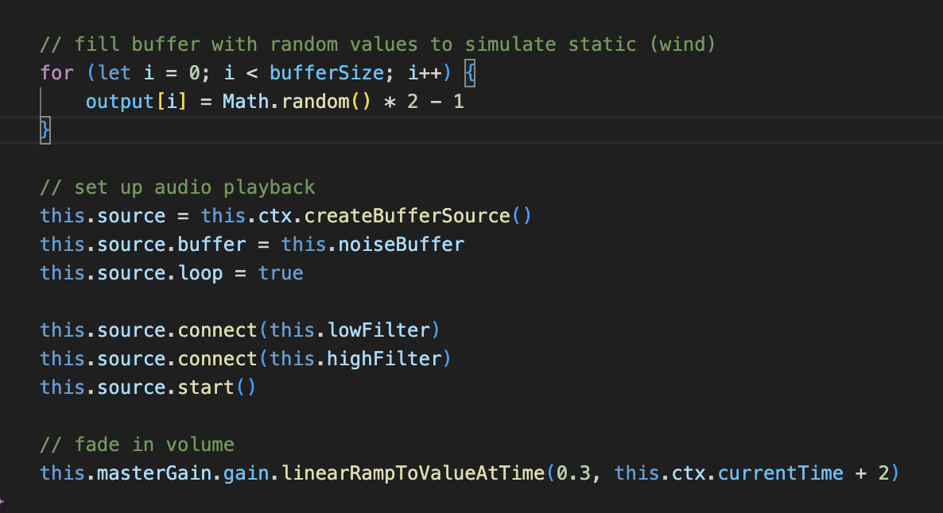
Code Snippet:
Create white noise
Create source as white noise
Connect source to filters and play noise
Code from startNoise function (called upon syncing weather)

Slide 7
Code Snippet:
Low Filter
Gain
Low Filter
Master
Gain
Destination
White Noise
High Filter
Gain
High Filter
Problem: Flat Sound → unrealistic

Slide 8
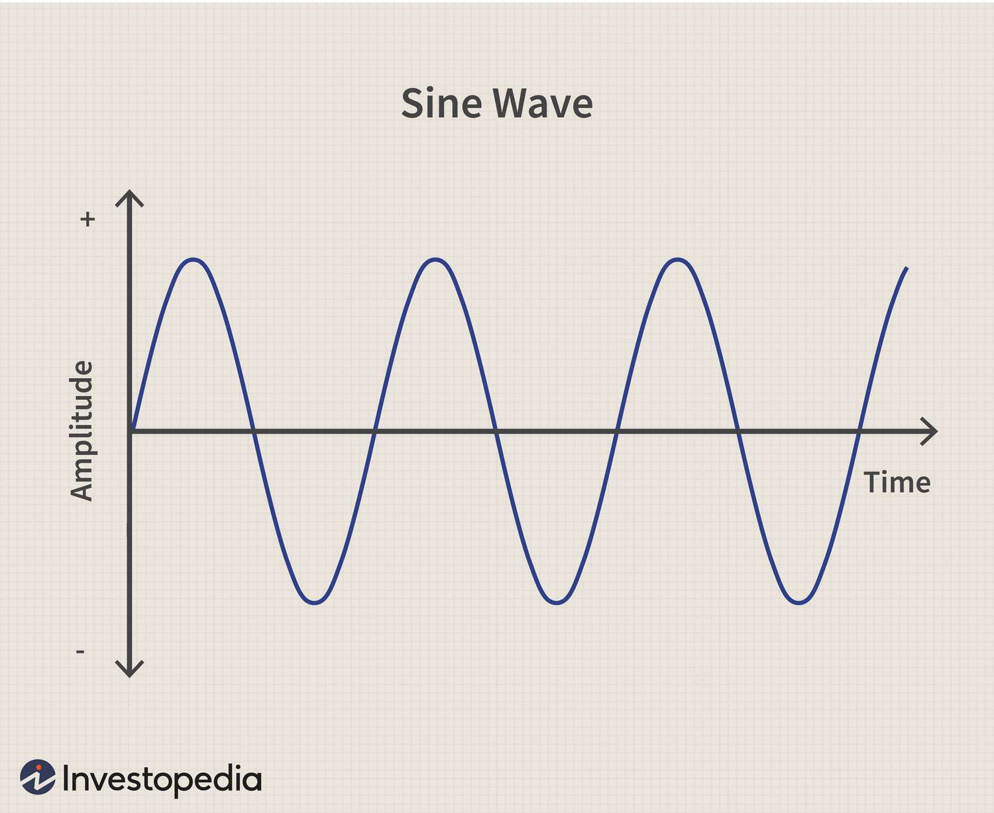
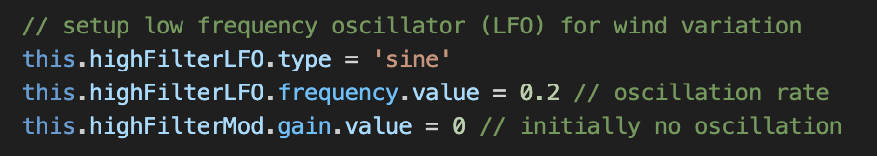
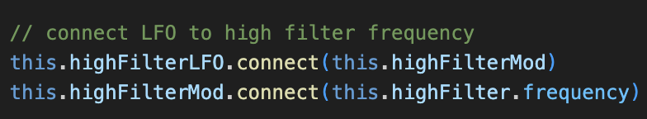
Code Snippet:
How to vary wind pitch?
Oscillators
createGain - strength control
Important: Connect to filter frequency

Slide 9
Code Snippet:
Low Filter
Gain
Low Filter
Master
Gain
Destination
White Noise
High Filter
Gain
High Filter
Frequency
High Filter LFO
High Filter MOD
Now have realistic wind sound!

Slide 10
Process:
Task | Tools Needed
Create Environmental Sounds | JavaScript (JS), Web Audio API
Fetch Weather At Current Location | JS, Open-Meteo API, Geolocation API
Play Sounds Based On Weather | HTML, Bootstrap CSS, JS
Update Visuals Based On Weather | HTML, Bootstrap CSS, JS
Add Manual Control for Sounds | HTML, Bootstrap CSS, JS

Slide 11
Issues Encountered:
Creating realistic wind sounds by hand
Dealing with delay from API calls
Debugging when API calls weren’t working as expected
Trying to get familiar with utility-first CSS styling

Slide 12
Skills Learned:
Familiarity with Web Audio API
Connecting HTML to JS using IDs
Manipulating HTML classes using JS for visual effect
Handling API calls (fetch, await, parsing .json)
Using Bootstrap CSS Grid (while aware of mobile-first)

Slide 13
Next Steps:
Add more sound options (crickets, waterfall, etc.)
Add volume dial for wind
Add nighttime environment (sound and visual theme)
Add more set weather conditions (thunderstorm, snow)

Slide 14
Final Project:
Adaptive Soundscape
Jacob Jiang

